Slide 1
Relationship Abuse & Sexual Violence Response Protocol Training
Supporting students affected by sexual assault, stalking, domestic or dating violence

Slide 2
Training Purpose
The Blaine School District knows that domestic violence, dating violence, and sexual violence affect students, staff, and communities.
You might see these problems at school or in your personal life. We want you to feel prepared.

Slide 3
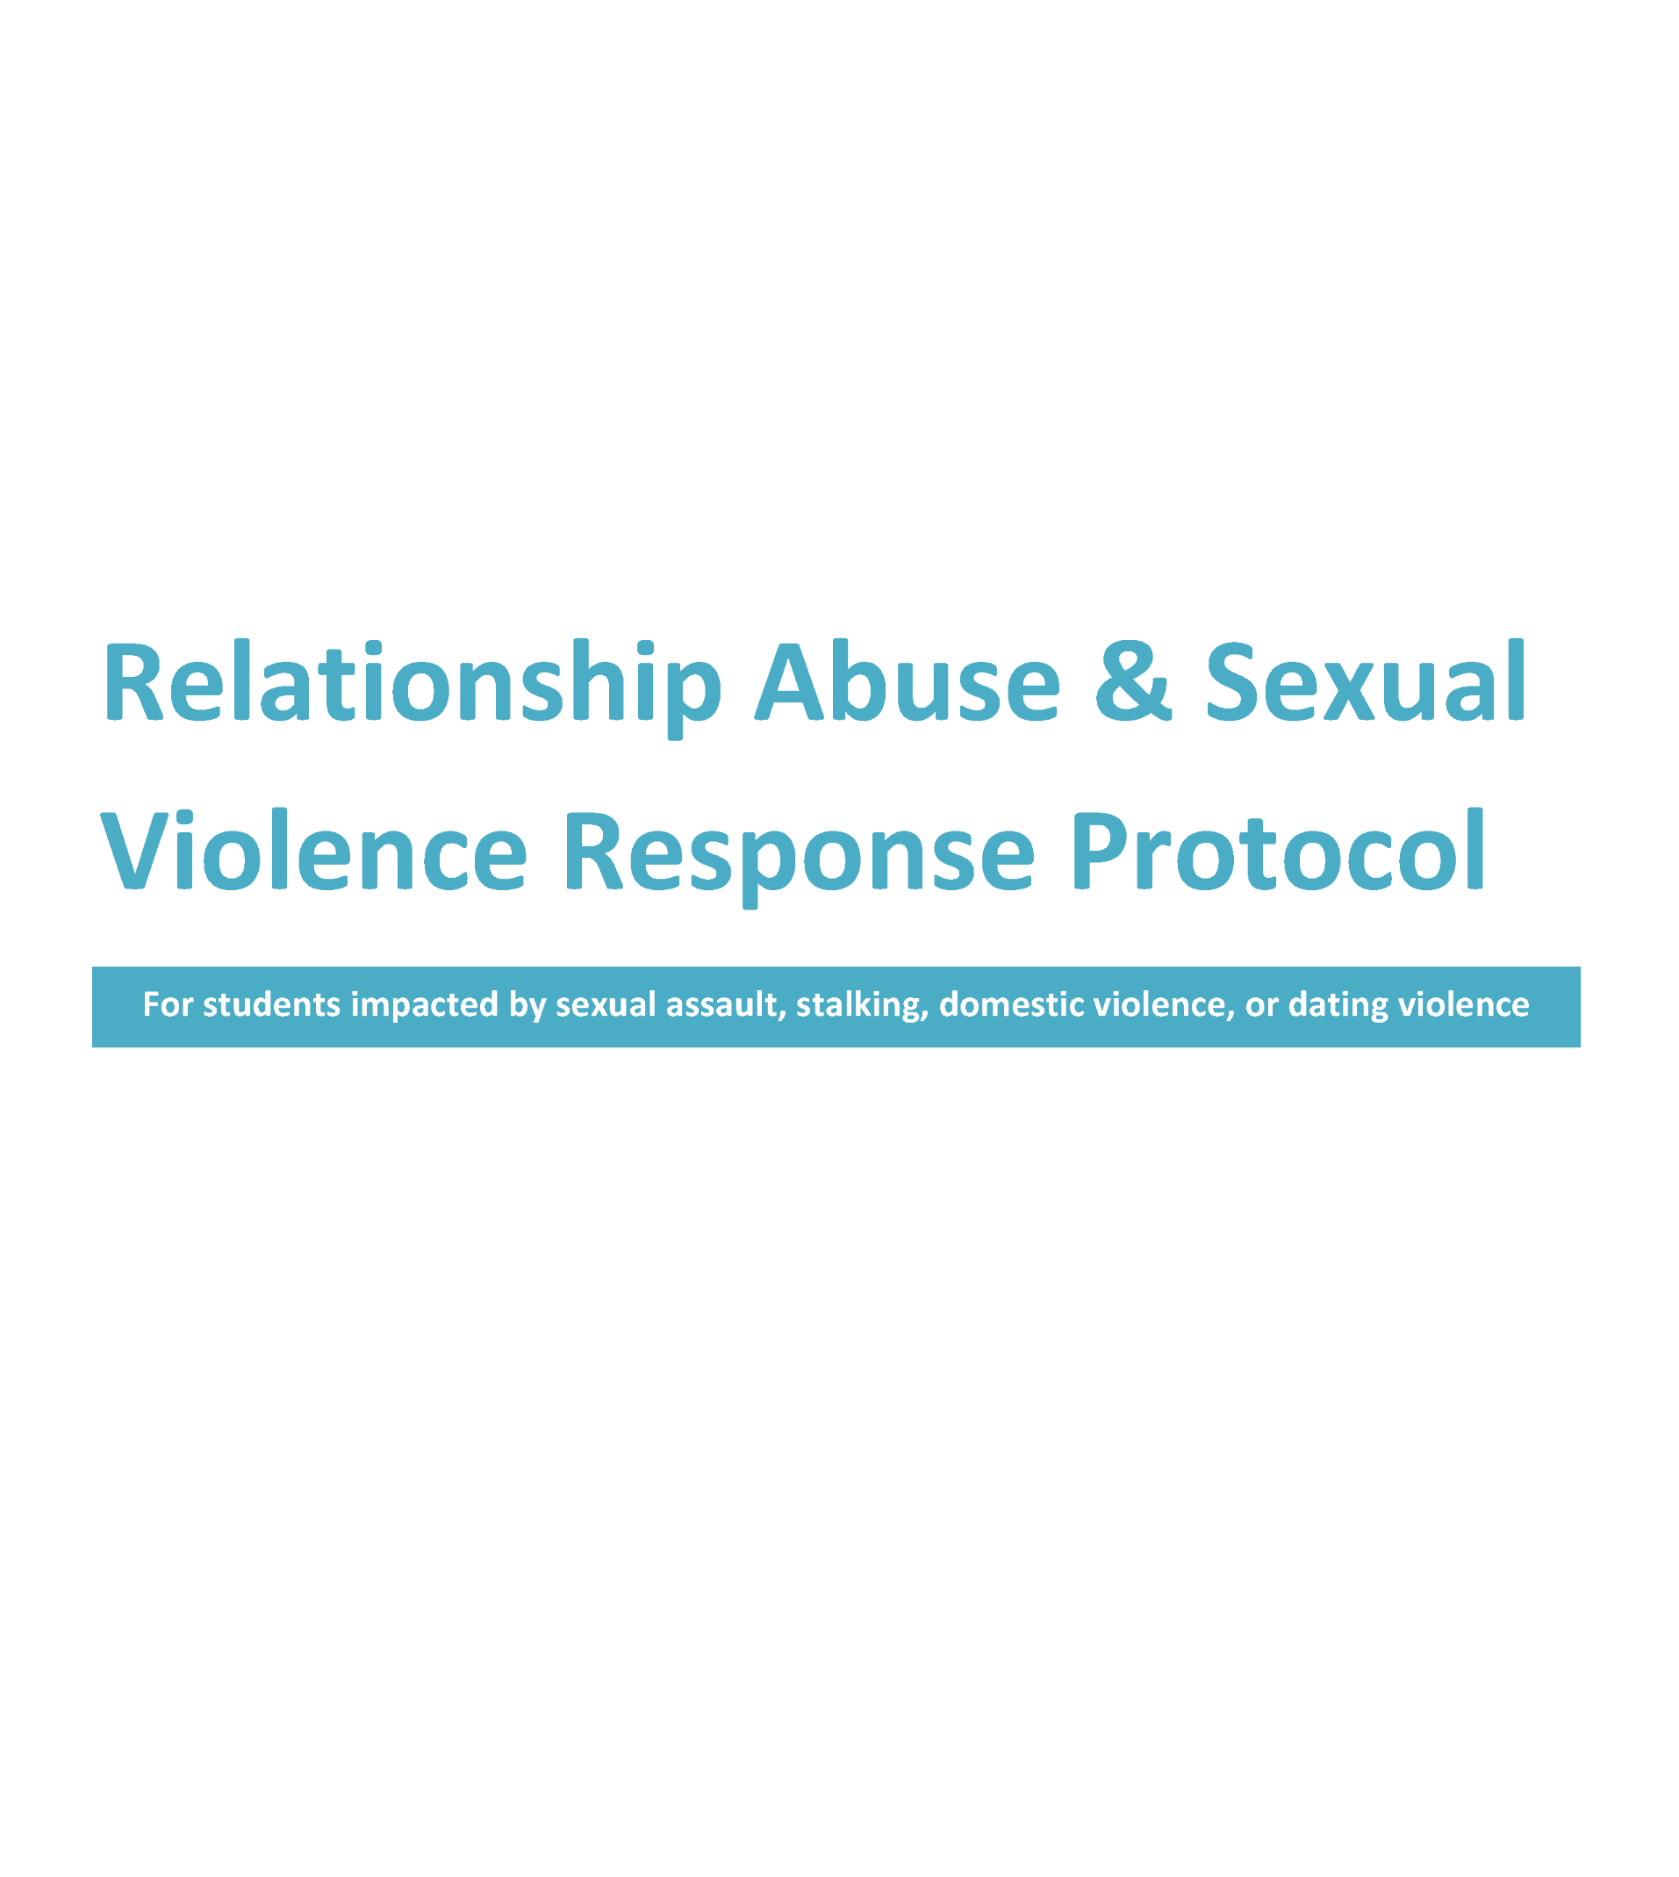

Slide 4
Local Support Resources
Domestic Violence Sexual Assault Services (DVSAS) of Whatcom County
www.dvsas.org
24-hour helpline: 1-877-715-1563
or (360) 715-1563
Lummi Victims of Crime (LVOC)
24-hour helpline: (360) 312-2015
The Northwest Network of Bi, Trans, Lesbian, and Gay Survivors of Abuse
www.nwnetwork.org
(206) 568-7777

Slide 5
Learning Objectives
Find related district policies
Define relationship abuse and sexual violence
Spot signs of sexual or dating violence in the life of a student
Follow the protocol and respond to students in a helpful way
Get in touch with local community resources

Slide 6
Creating Safe Learning Environments
It is the policy of our district to create a safe and caring place for students to learn.
Sexual Harassment Against Students Prohibited
(Policy 3205 and 3205P)
Harassment, Intimidation, and Bullying Against Students Prohibited
(Policy 3207 and 3207P)

Slide 7
Creating Safe Learning Environments
This School District strives to create a culture of care where all individuals feel safe, valued, and respected. Violence of any kind is a violation of human rights and an obstacle to learning. Sexual violence, sexual harassment, and dating violence are specific types of violence that are addressed under our policies because they limit potential, thrive in silence, and exist for many reasons.

Slide 8
Creating Safe Learning Environments
Creating a safe setting for learning starts with YOU – the helpful tools you’ll learn today can make a difference in the lives of students, family members, coworkers, or anyone else you care about.

Slide 9
What is Relationship Abuse?
A pattern of behaviors used to gain power and control over another person, usually a romantic partner.

Slide 10
What is Consent?
Consent is an expression of expectations and a respect for boundaries. It is a conversation that requires sharing power.
Some young people between the ages of 12 and 16 cannot legally consent to sexual contact, depending on the age or role of the other person.
Consent can never be freely given by certain people, like anyone under the age of 12 and vulnerable youth or adults with certain mental or physical disabilities.

Slide 11
What is Sexual VIOLENCE?
Sexual violence is any type of sexual contact without consent.
At school, sexual violence and sexual harassment mean any type of sexual gesture, communication, or physical contact that makes others feel threatened or intimidated.
Sexual violence includes behaviors from sexual harassment to sexual assault or rape.

Slide 12
What is Sexual ASSAULT?
Sexual assault happens when a person is forced into sexual acts without their clear consent.
This includes all kinds of sexual behavior where someone is forced, tricked, pressured, or feels violated.

Slide 14
Who is Affected?
Domestic and sexual violence can happen to anyone, including:
Elders and teens
Women, men, and people who are non-binary
People who identify as LGBTQ+
People with disabilities
Children can experience trauma living in a home with domestic violence.
Children can be sexually abused or assaulted.

Slide 15
How to Identify Sexual & Domestic Violence
Most people don’t talk about relationship abuse and sexual violence. When we do hear about it, we might get wrong information about why it happened and who is at fault.
Your response can either repeat harmful messages or challenge them.

Slide 16
These behaviors could indicate a problem in the life of a student:
Suspiciousness or accusations of cheating
Physically inflicting pain or hurt in any way
Isolation from family and friends
Constant mood swings
Telling a partner what they can and cannot do

Slide 17
These behaviors could indicate a problem in the life of a student:
Ignoring privacy and boundaries, like checking the other person’s cell phone, email, or social networks
Extreme jealousy, possessiveness, or insecurity
Belittling, name-calling, or put-downs
Explosive temper
Coercing or pressuring someone to have sex

Slide 18
If you are concerned about a student:
1. Approach the student privately
2. Explore that concern, with the goal of offering support, not to do an investigation
3. DO NO HARM

Slide 19
If you are concerned the student may be a victim:
you can say…
I care about you and have been worried about you lately. How would you feel about walking to the counselor’s office together so you can get some support?

Slide 20
If you are concerned the student may know a victim:
you can say…
I thought I heard you say something about sexual contact that did not sound consensual. Alcohol and consent can be tricky. I am worried about that person’s safety and would like to help.

Slide 21
Trauma & Healing
Healing from trauma happens through connection.
How YOU respond can make a difference in a survivor’s healing.

Slide 22
If a student tells you about a dating or sexual violence incident:
Believe, support, & validate
2. Tell the student the plan: that you are going to contact the school counselor
3. Determine if a law enforcement or CPS report is required: tell the student if you will be making a report
4. Contact the school counselor

Slide 23
Mandated Reporters Should:
1. Tell the student that you are required to make a report to law enforcement or CPS, and invite the student to participate in report.
2. Do not investigate the report.
3. Inform your administrator.
4. Report to CPS or law enforcement.
5. Offer to have a DVSAS or Lummi Victims of Crime (LVOC) advocate meet with the victim during the police or CPS interview.
6. Call DVSAS or LVOC to inform them of time/location of the interview.
7. Take down contact information of the people responding and ask about the best way to follow up.

Slide 24
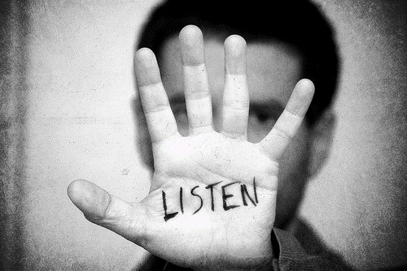
How to Talk to a Student About an Incident
Believe
Support
Validate

Slide 25
How to Talk to a Student About an Incident
I’m sorry to hear this has happened to you.
This was not your fault.
You deserve to be treated with respect.
What do you need?

Slide 26
How to Talk to a Student About an Incident
I believe you.
I’m so glad you came to talk to me.
This is important.
I know this must be uncomfortable. Please take your time .
This sounds like a difficult experience.

Slide 27
DO
Talk to the student in a safe setting, away from other students
Recognize that the student may be fearful, confused, and/or vulnerable
Believe them: It takes a lot of courage to tell an adult and it can be devastating to hear that someone doesn’t believe you
Ask them what they think will make them feel safer and if they feel comfortable telling friends or family what is going on

Slide 28
DO
Support by actively listening
Respect their privacy: Only tell the people who need to know about the situation
Think about the questions you ask and what you need to know – are you asking questions for your own curiosity?
A student could feel blamed by questions related to drug or alcohol use, what the student was wearing at the time, or about their other choices.

Slide 29
DON’T
Minimize or downplay the situation
Place any blame on the victim
Give advice
Make promises you can’t keep

Slide 30
DON’T
Ask if they were drinking
Ask what they were wearing
Lecture the student about what you think was poor judgment or choices

Slide 31
If a student tells you about a dating or sexual violence incident:
1. Believe, support, & validate
2. Tell the student the plan: that you are going to contact the school counselor
3. Determine if a law enforcement or CPS report is required: tell the student if you will be making a report
4. Contact the school counselor

Slide 32
If a student tells you about a dating or sexual violence incident:
1. Believe, support, & validate
2. Tell the student the plan: that you are going to contact the school counselor
3. Determine if a law enforcement or CPS report is required: tell the student if you will be making a report
4. Contact the school counselor

Slide 33
If a student tells you about a dating or sexual violence incident:
1. Believe, support, & validate
2. Tell the student the plan: that you are going to contact the school counselor
3. Determine if a law enforcement or CPS report is required: tell the student if you will be making a report
4. Contact the school counselor

Slide 34
Summary
You are an important person in student’s lives. You can help survivors by:
Believing, supporting, and validating them.
Listening and making supportive statements. It is not helpful to ask a lot of questions.
Connecting them with the school counselor.

Slide 35
Local Support Resources
Domestic Violence Sexual Assault Services (DVSAS) of Whatcom County
www.dvsas.org
24-hour helpline: 1-877-715-1563
or (360) 715-1563
Lummi Victims of Crime (LVOC)
24-hour helpline: (360) 312-2015
The Northwest Network of Bi, Trans, Lesbian, and Gay Survivors of Abuse
www.nwnetwork.org
(206) 568-7777

Slide 36
Thank you to the Department of Justice, Office on Violence Against Women, for funding this project.
This project was supported by Grant No. 2015-CY-AX-0012 awarded by the Office on Violence Against Women, U.S. Department of Justice. The opinions, findings, conclusions, and recommendations expressed in this packet are those of the author(s) and do not necessarily reflect the views of the Department of Justice, Office on Violence Against Women.

